Slide 1
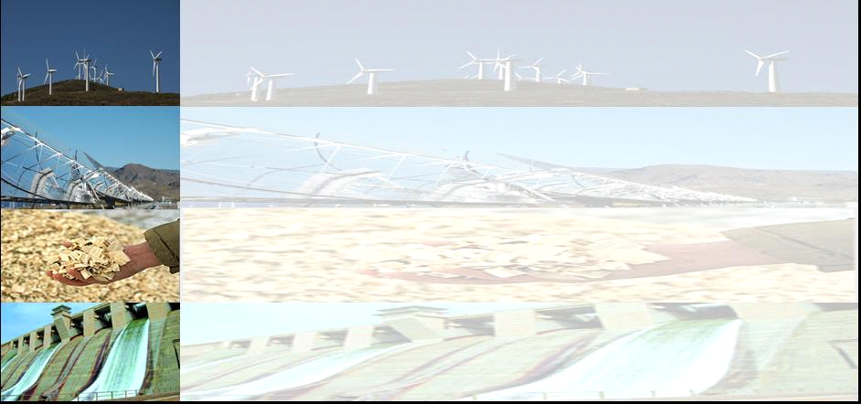
ELECTRICITY MARKETS, AND THE ROLE OF RENEWABLES & NUCLEAR
Reinhard Haas
Energy Economics Group,
Vienna University of Technology
PRAGUE 2.2.2016

Slide 2
SURVEY
1. Introduction: Historical background
2. How prices come about (theory)
3. Environmental issues: CO2-prices
4. How prices developed in Europe
5. Electricity generation costs
6. Recent developments of nuclear
7. The role of Renewables
8. Conclusions

Slide 3
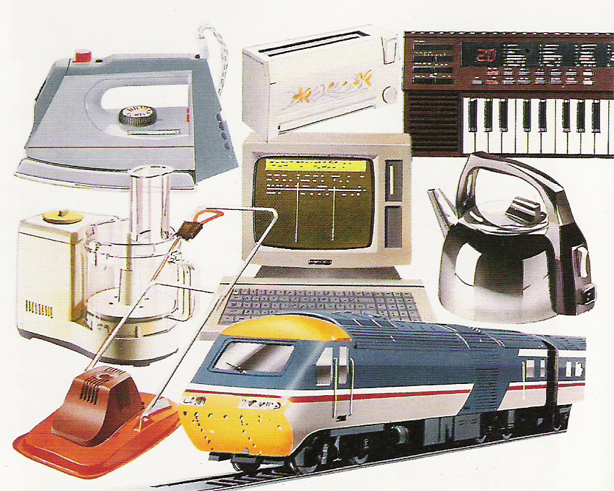
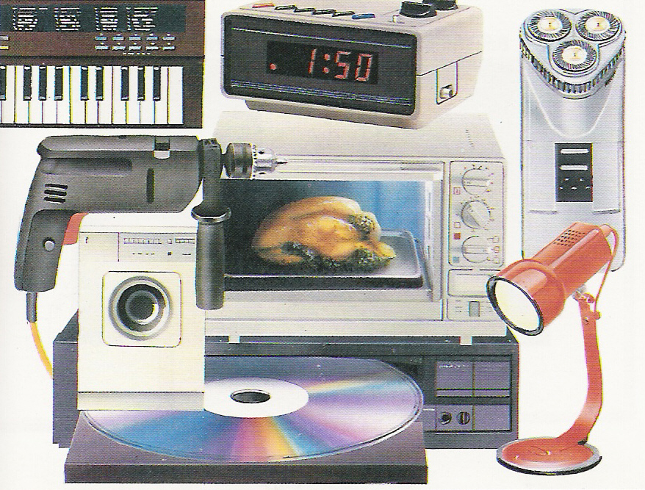
OUR LIFE:
PERMANENTLY UNDER
ELECTRICITY
Electricity – THE universal technology for providing energy services

Slide 4
1. INTRODUCTION:
CORE OBJECTIVE
How to provide access to electricity „optimal“ from societies point-of-view?
What is the optimal political „structure“? Private, price (de-)regulation ….
How to bring about a transformation to a sustainable energy system?

Slide 5
THE EU-DIRECTIVE(S) 1
The European Commission’s main expectation …. was the belief that
“market forces [would] produce a better allocation of resources and greater effectiveness in the supply of services”
Intentions of the EC directive:
Competitive markets
lower electricity prices
more environmentally benign

Slide 6

Global Electricity generation

Slide 7
Global Electricity
1973
2014

Slide 8
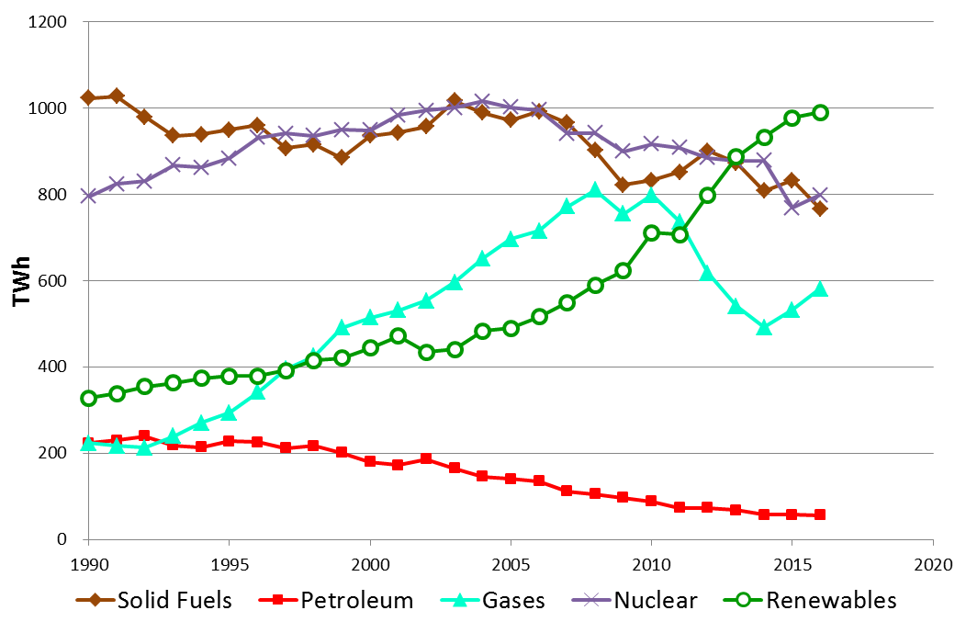
1. Introduction:
Electricity generation EU-28

Slide 9
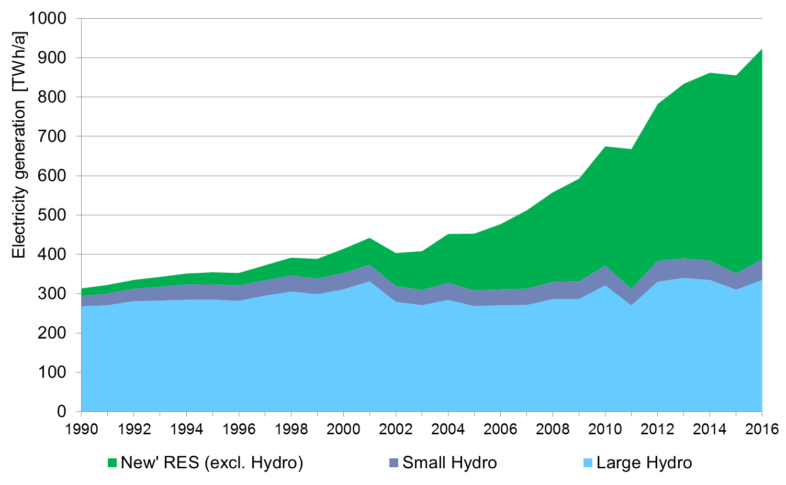
EU-28: Electricity
generation from RES
2016: 28 %
(2016 preliminary)
1997: 12 %
Source: EUROSTAT, own estimations

Slide 10
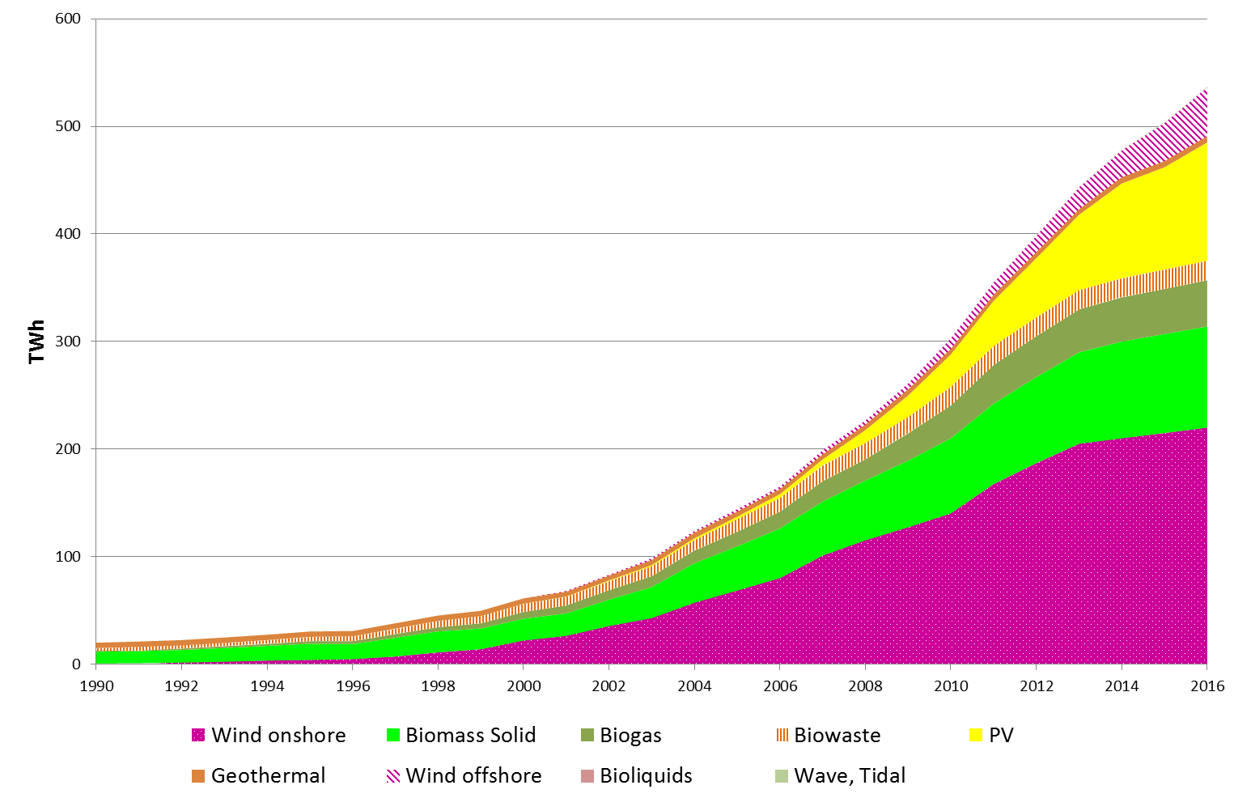
EU-28: Electricity generation
from „new“ RES
2016: 16 %
(preliminary)
1997: 1 %
Source: EUROSTAT, own estimations

Slide 11
2 HOW PRICES COME
ABOUT (SOME THEORY)
before liberalisation
after liberalisation
Strategic prices
Average
costs
Price, costs (EUR/MWh)
Long-term
marginal costs
Short-term
marginal costs
time

Slide 12
THE MERIT-ORDER
CURVE OF SUPPLY
based on short-term marginal costs (MC)
Coal (old)
Supply curve S:
marginal costs
Costs (EUR/MWh)
Natural gas (new)
Nuclear
Hydro, Wind
MWh

Slide 13
BASIC PRINCIPLE OF
COMPETITION:
PRICE = MARGINAL COSTS
Demand D
Coal (old)
p_{t1}
Natural gas (new)
Price = „System“-marginal costs
Supply
curve S
Costs,Price (EUR/MWh)
Nuclear
Hydro, Wind
MWh

Slide 14
BASIC PRINCIPLE OF COMPETITION:
PRICE = MARGINAL COSTS
Demand
D_{t1}
Demand
D_{t2}
p_{t2}
Price = „System“-marginal costs
p_{t1}
Supply
curve S
Costs,Price (EUR/MWh)
MWh

Slide 15
LONG-TERM
VS
SHORT-TERM
MARGINAL COSTS

Slide 16
What are marginal costs (MC)?
MC= C‘(X) = dC(x)/dX
Marginal costs are the increment of costs due to a generation of one additional unit of kWh
P=MC
Short-term marginal costs (STMC):
STMC= Fuel costs + CO2 costs
Long-term marginal costs (LTMC):
LTMC= STMC + Capital costs + O&M costs

Slide 17
LONG-TERM MARGINAL
COSTS
1.
2.
3.
Cheapest:
Nuclear
Coal
Wind
Costs (EUR/MWh)
Capital costs
Operation/Fuel costs
CO2 costs

Slide 18
SHORT-TERM MARGINAL
COSTS
3.
2.
1.
Cheapest:
Coal
Costs (EUR/MWh)
Nuclear
Wind
Operation/Fuel costs
CO2 costs

Slide 19
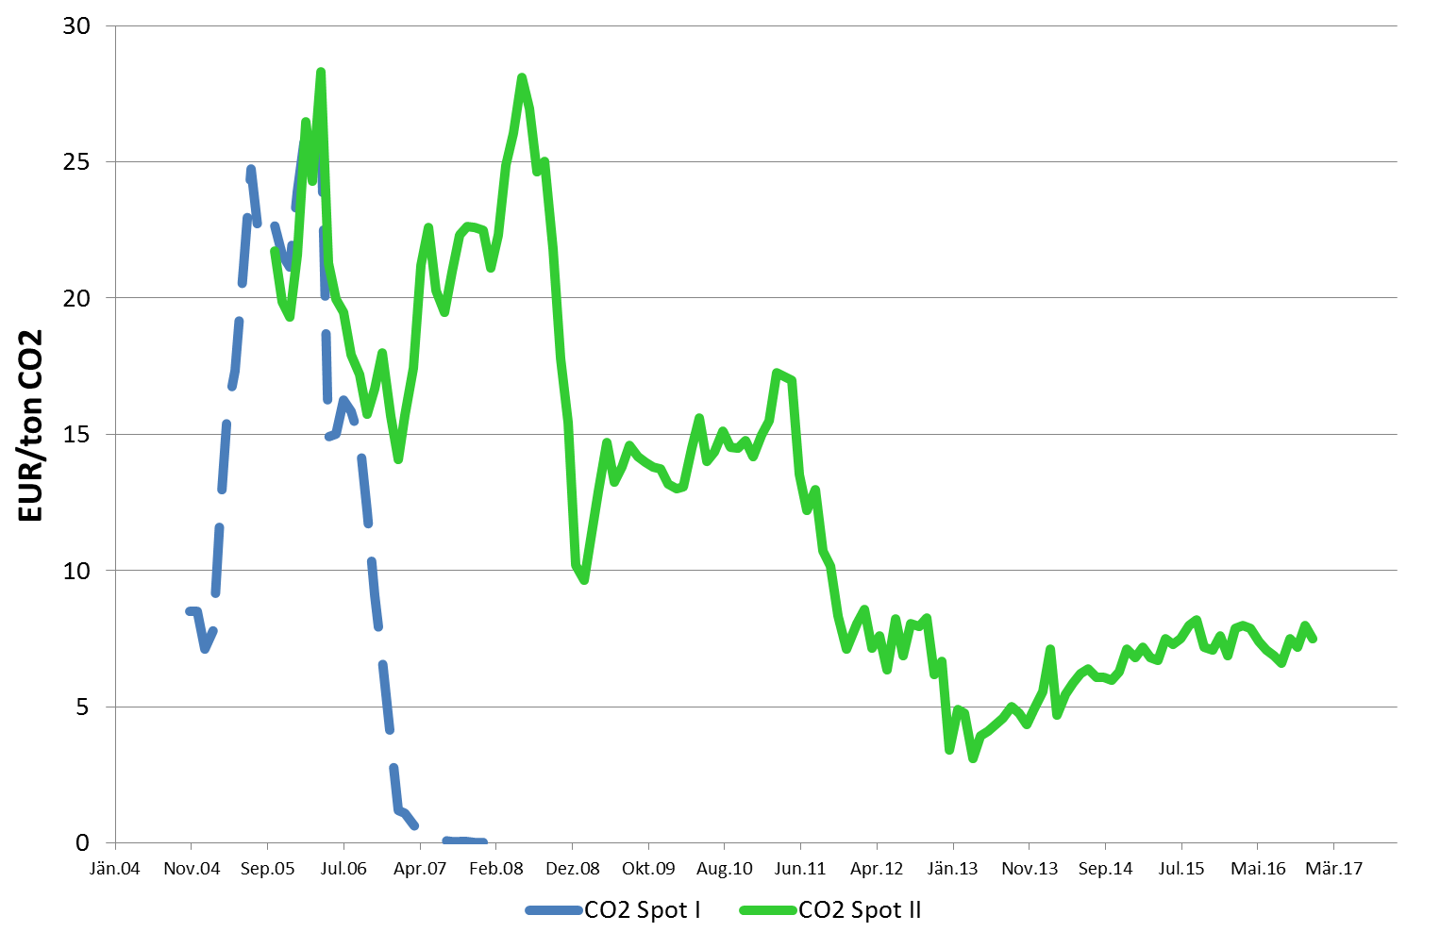
3 ENVIRONMENTAL
ASPECTS – THE CO2-PRICE

Slide 20
EMISSION TRADING‘S
BENEFIT FOR ELECTRIC UTILITIES
CO2-certificates
purchased on the
market
Market price with ET
P_{Cert}
„Windfall profits“!
Market price without ET
Total producer
surplus electricity
CO2-certificates
allocation plan
EURO/kWh
Cost curve
D
Hydro
Nuclear
Gas
Coal
kWh

Slide 21
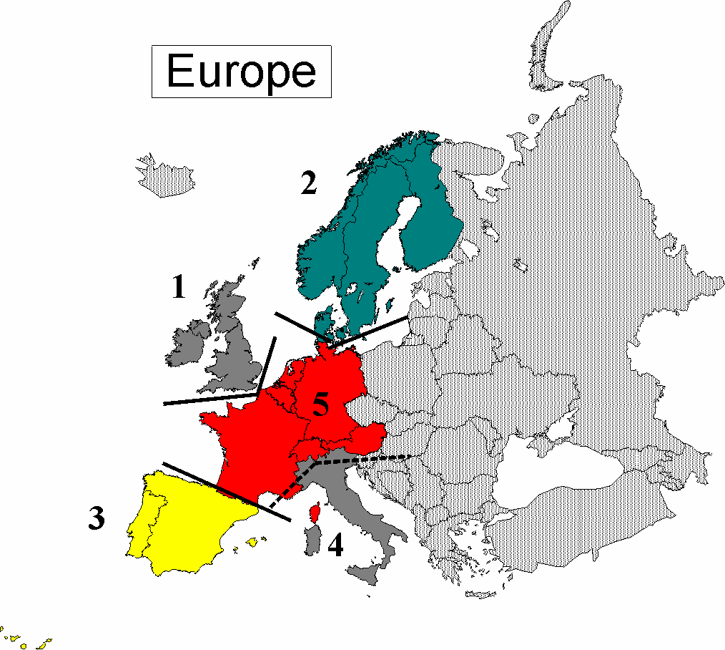
4 HOW PRICES
DEVELOPED IN EUROPE
EUROPEAN ELECTRICITY SUB-MARKETS
1. UK & Ireland
2. Nordic countries
3. Iberian peninsula
4. Italy
5. Western Europe
6. Eastern Europe
7. South-Eastern Europe
6
5
7

Slide 22
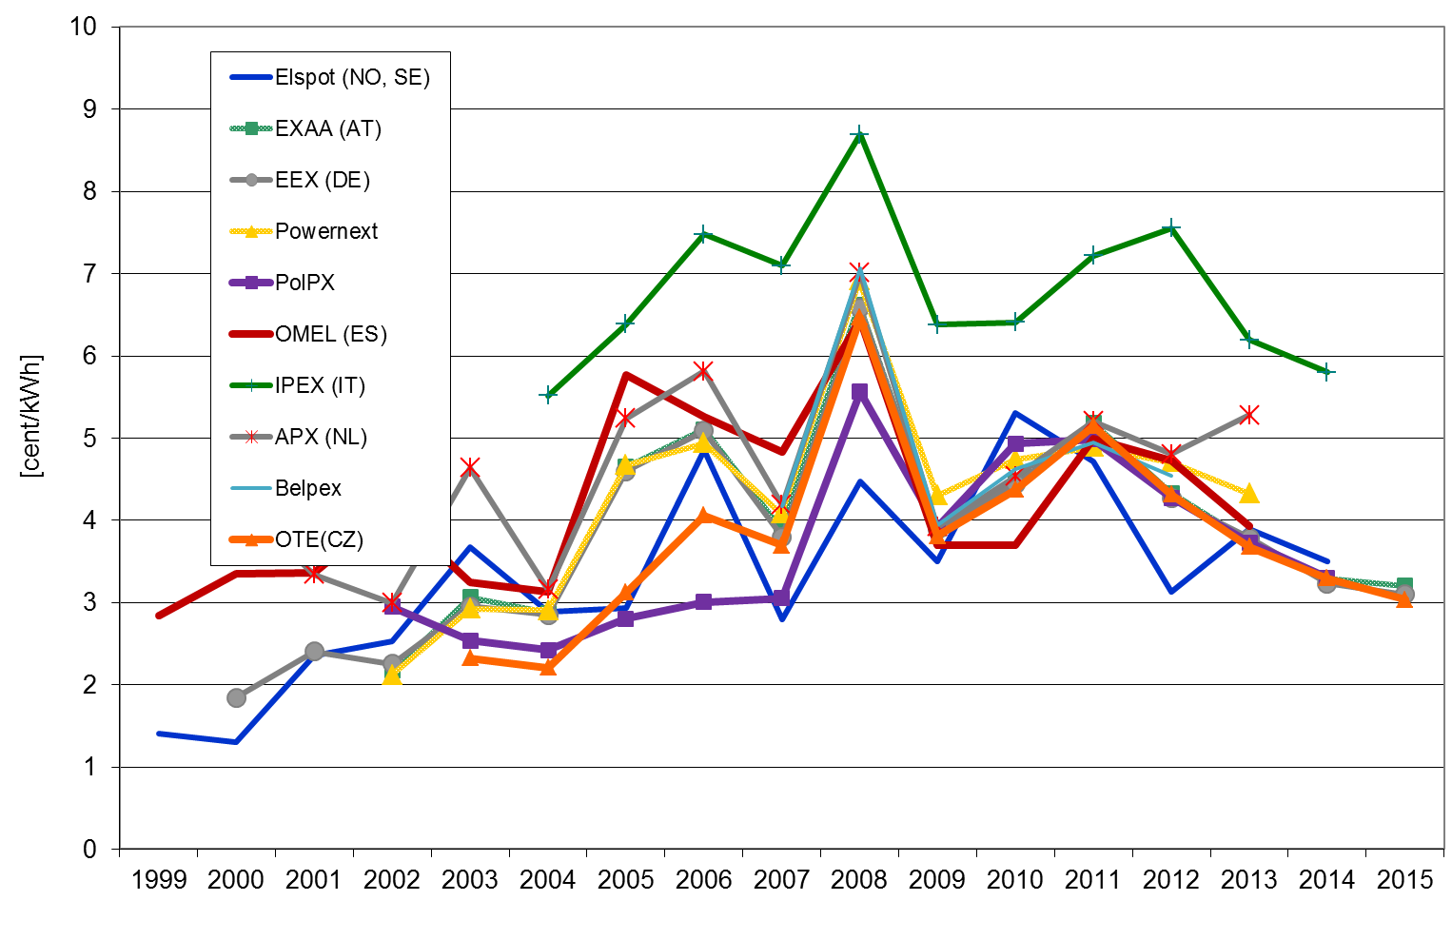
Development of day-ahead
electricity prices in Europe per year
AT, DE, FR, CZ, PL
→ One market!
Italy
Nordpool

Slide 23
5 ELECTRICITY
GENERATION COSTS
ANNUITY METHOD
Distribute investments to annuities
(annual payback amounts)
I
A
A
A
A
0
1
2
3
. . . . . . .
n

Slide 24
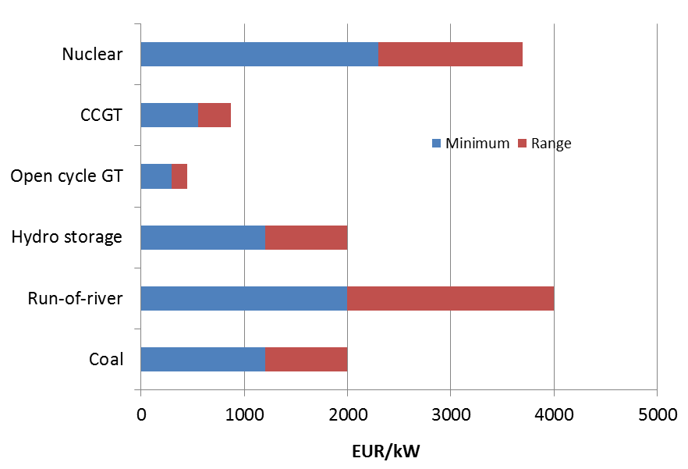
Investment costs
Electricity generation Conventional 2015

Slide 25
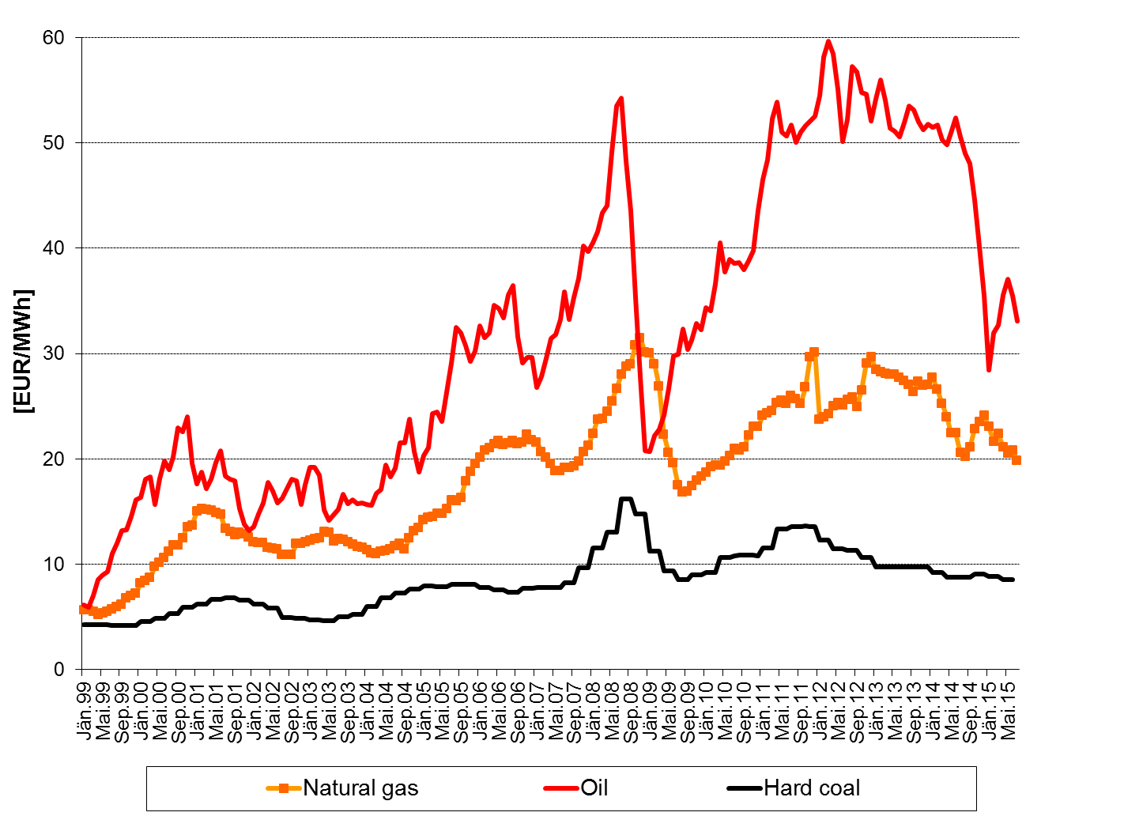
  Fossil fuel prices 1999-2015

Slide 26
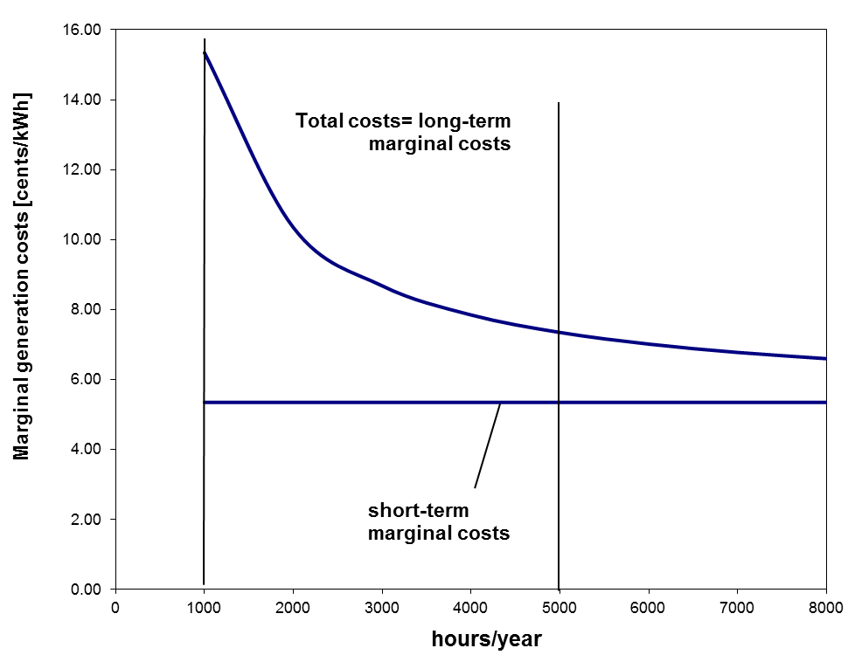
Generation costs CCGT
Fixed costs
per kWh
1000
5000

Slide 27
Costs of electricity generation
I α +C_{O&M} p_{f} C_{CO2} f_{CO2} cent
C = C_{F} + C_{V} = ———— + —— + ———— [——]
T H η η kWh
where:
C …Total costs of electr. Generation (cent per kWh)
C_{F} …Fix costs (cent per kWh)
C_{V} … Variable costs (cent per kWh)
C_{O&M}…Operation & maintenance costs (EUR/kW)
I ….Investment costs (EUR/kW)
… C.R.F. (Capital recovery factor, e.g. 0.1 for 15 years, 5% WACC)
T ….Full load hours (hours per year)
p_{f} …Fuel price (cent/kg or m³)
H …Caloric heat content (e.g. 10 kWh per m³ for gas)
η …Efficiency of power plant
C_{CO2} …Price of CO2 (e.g. 5 EUR/ton Carbon)
f_{CO2} … CO2-factor of fuel (0.2 kg Carbon/kWh)

Slide 28
Example: Costs of
electricity generation from CCGT
I ….Investment costs = 600 EUR/kW
… C.R.F. = 0.1 for 15 years and 5% interest rate
T ….Full load hours = 5000/1000 hours per year
C_{O&M}…Operation & maintenance costs = 20 EUR/kW
p_{f} …Fuel price (e.g. 25 cents/m³ natural gas)
H …Caloric heat content (e.g. 10 kWh per m³ for gas)
η …Efficiency of CCGT plant = 0.58
C_{CO2} …Price of CO2: 5 EUR/ton Carbon)
f_{CO2} … CO2-factor of fuel (0.2 kg Carbon/kWh)

Slide 29
Example: Costs of
electricity generation from CCGT

Slide 30
Investment costs
Electricity from new renewables 2010

Slide 31
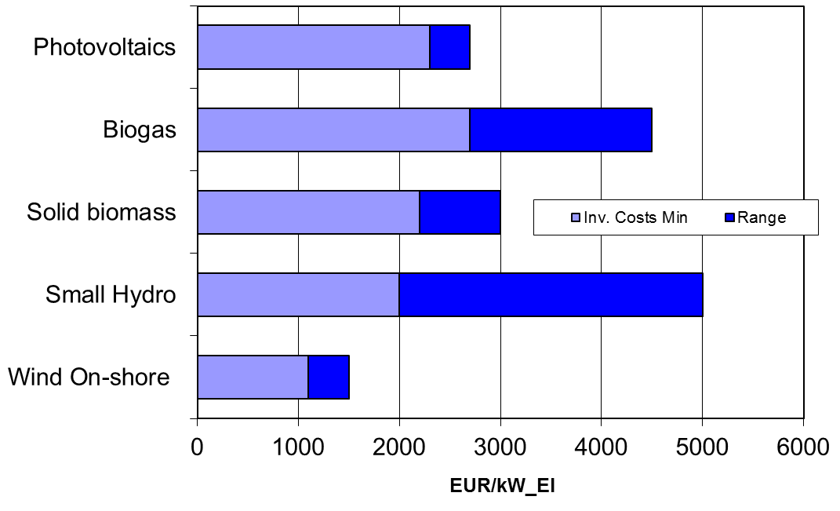
Investment costs
Electricity from new renewables 2016

Slide 32
Generation costs
Electricity from new renewables 2010

Slide 33
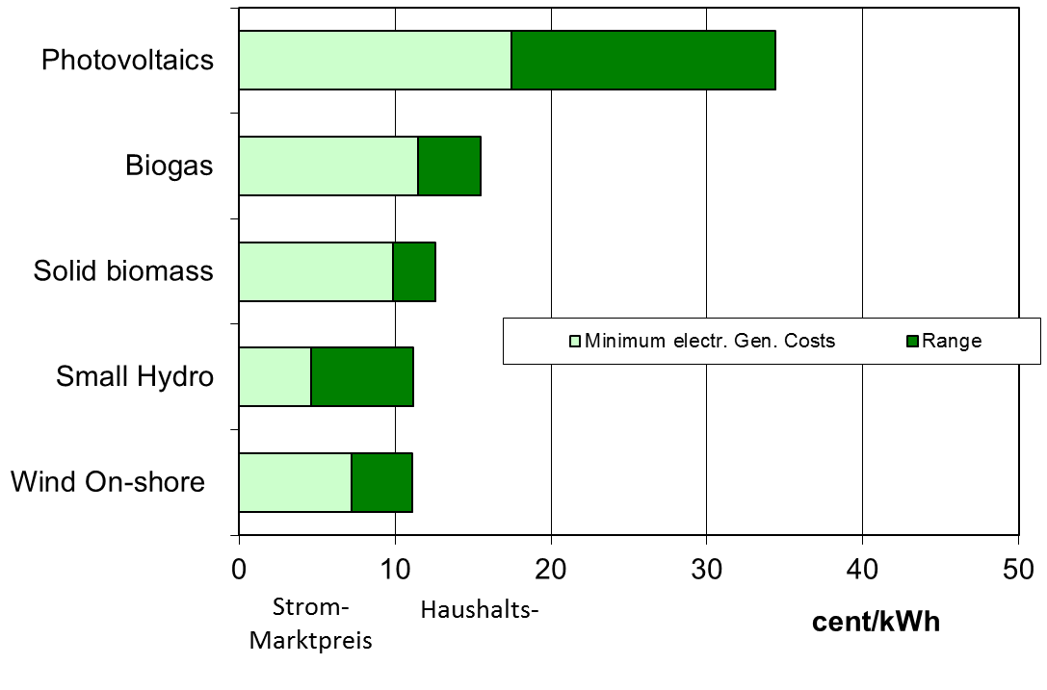
Generation costs
Electricity from new renewables 2015
Wholesale
electricity price
Household
electricity price

Slide 34
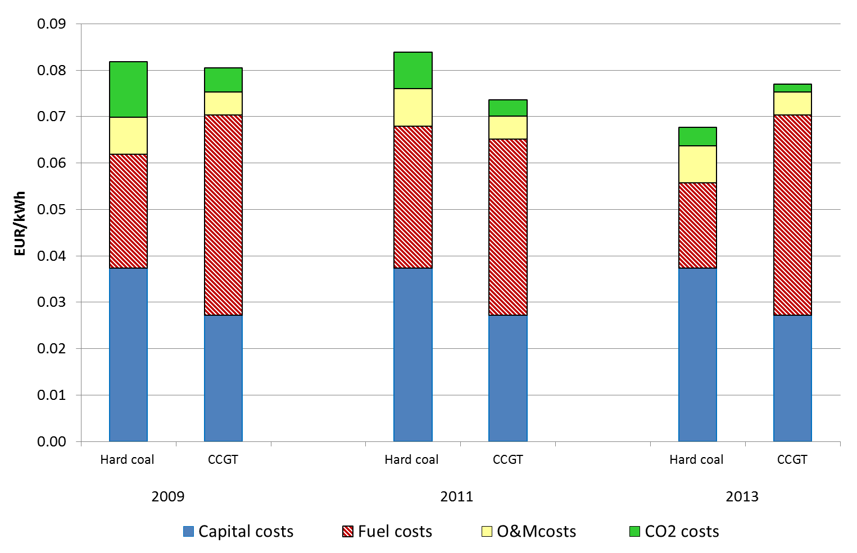
Total electricity generation costs 2009-2013

Slide 35
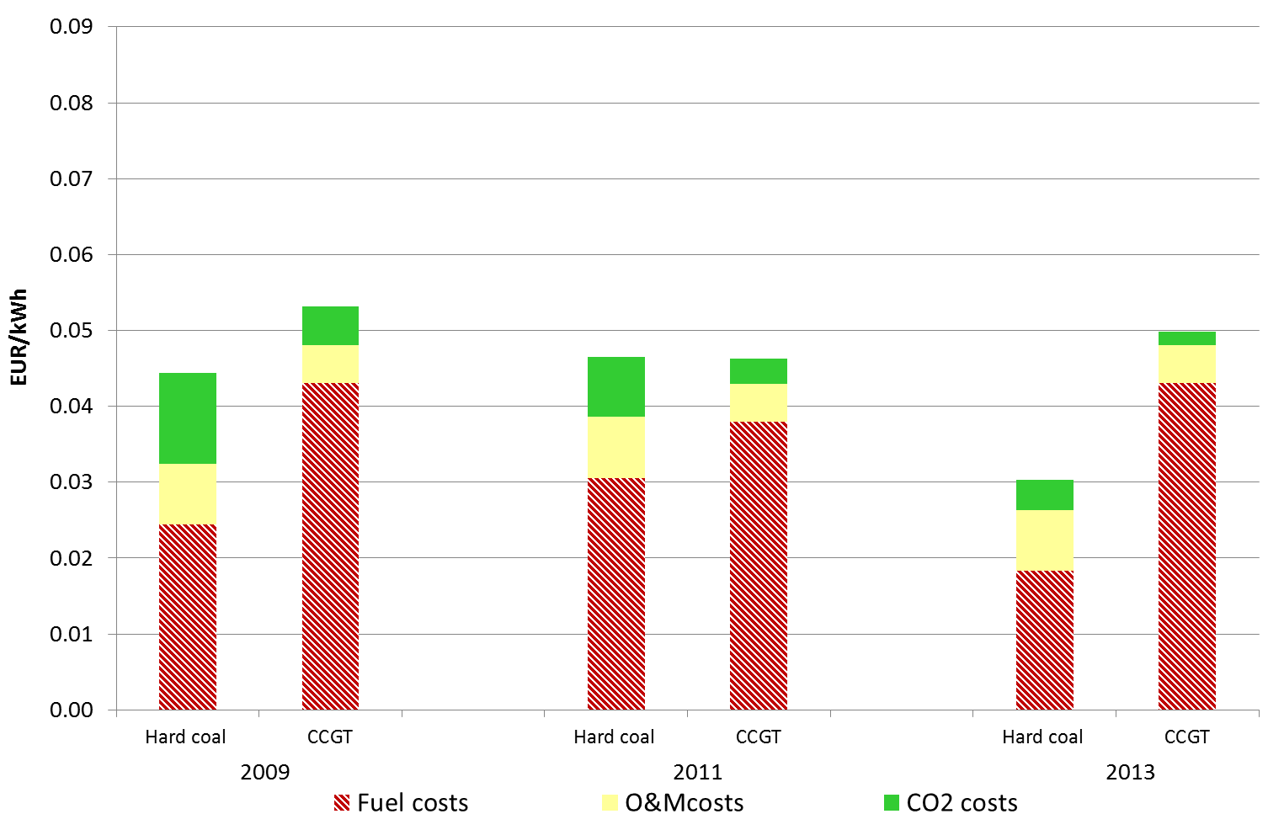
Variable electricity generation
costs 2009-2013

Slide 36
6. RECENT DEVELOPMENT OF NUCLEAR COSTS
Olkiluoto-3 (Finland): Construction started in 2004, now
expected to be completed 2019 (originally: 2009); 1600 MW
Flamanville-3 (France): Construction started in 2006, now
expected to be completed 2019 (originally: 2011); 1600 MW

Slide 37
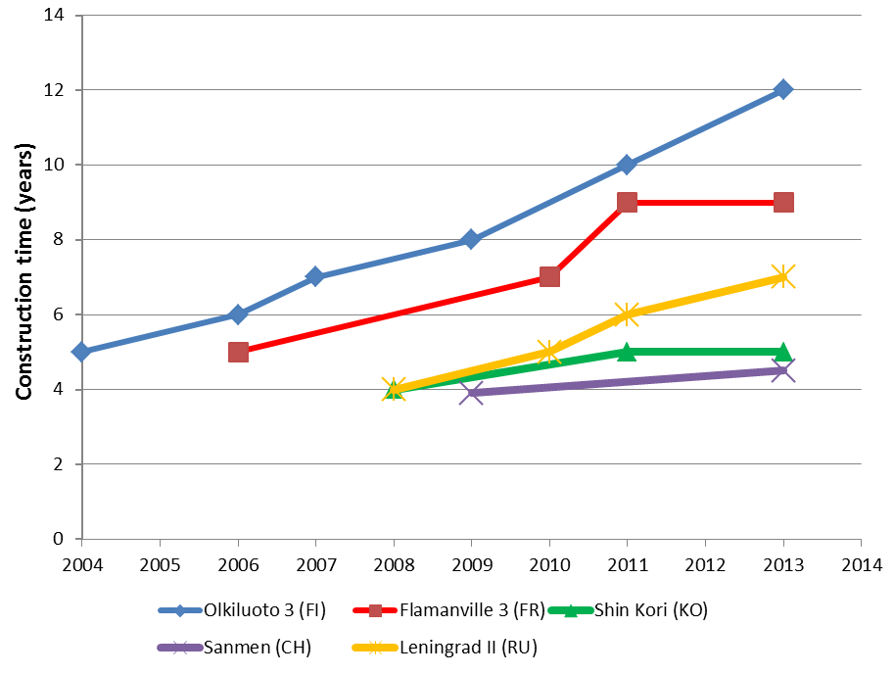
Construction times

Slide 38
Impact of construction time
on investment costs: Example Olkiluoto

Slide 39
Impact of construction time
on investment costs: Example Olkiluoto

Slide 41
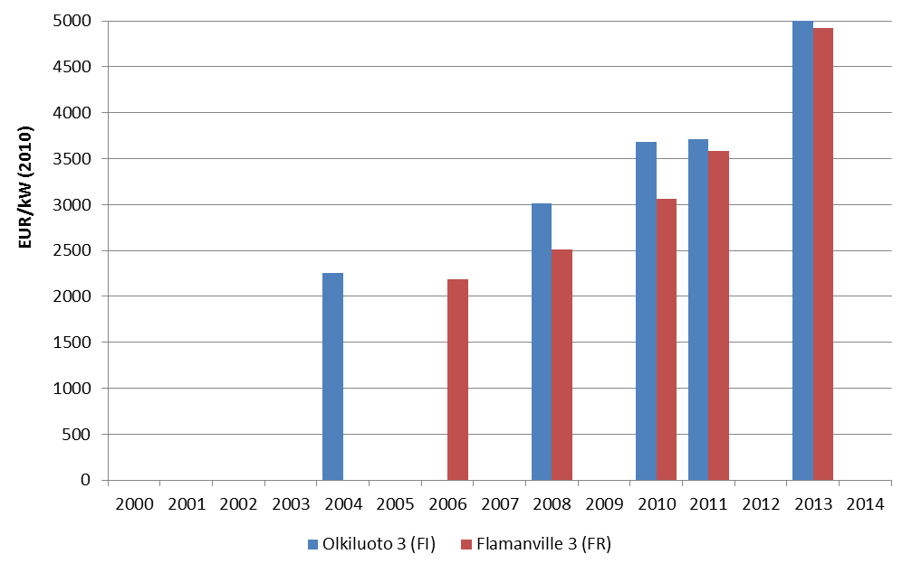
Investment cost development
Olkiluoto 3 vs Flamanville 3

Slide 42
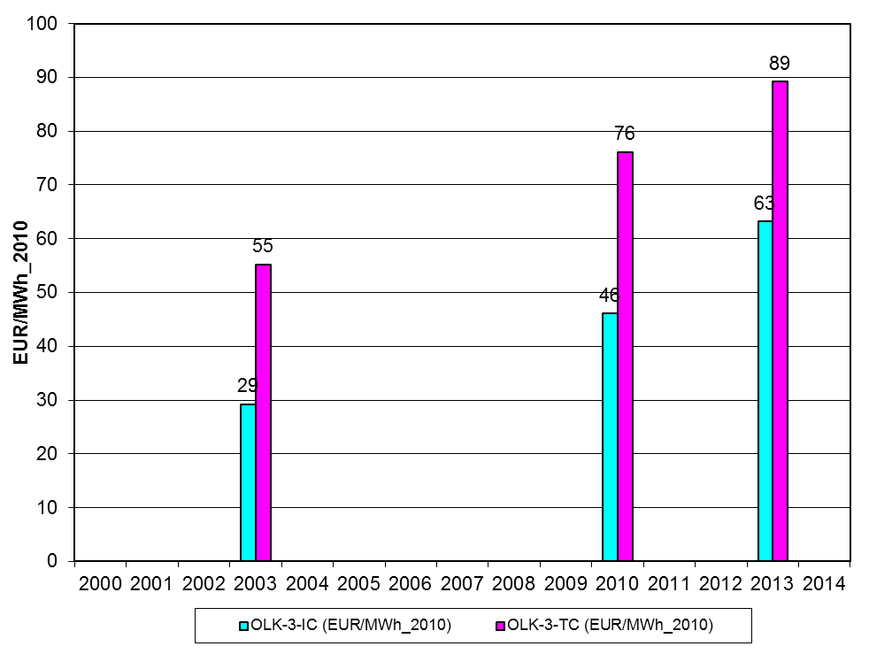
„Total“ Cost development
Olkiluoto
No insurance costs considered!

Slide 43
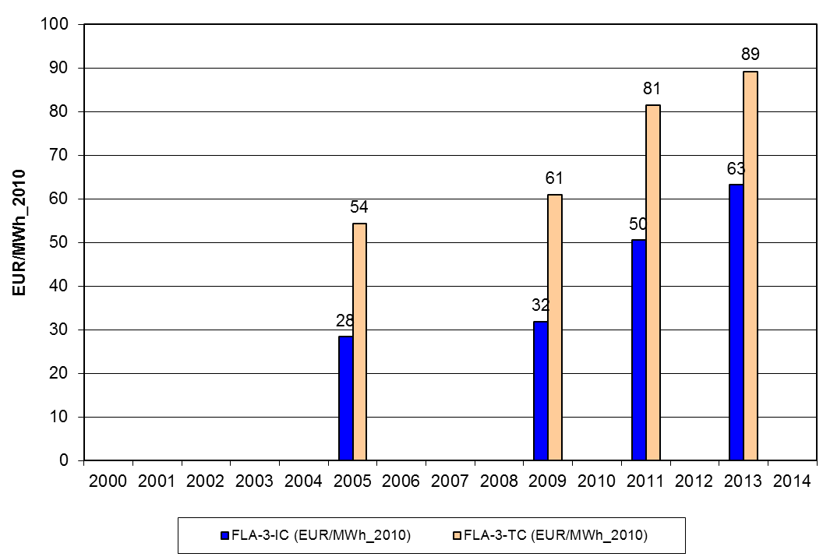
„Total“ Cost development
Flamanville-3
No insurance costs considered!

Slide 44
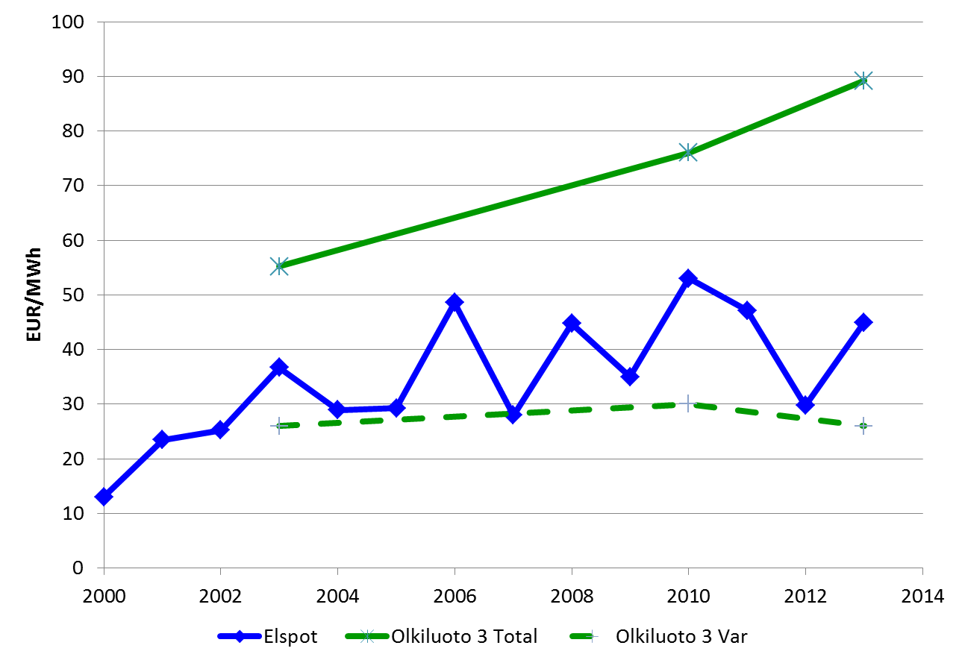
Costs vs market
prices in Nordic countries
„Total“ costs Olkiluoto
Electricity price
NORDPOOL
Variable costs Olkiluoto

Slide 45
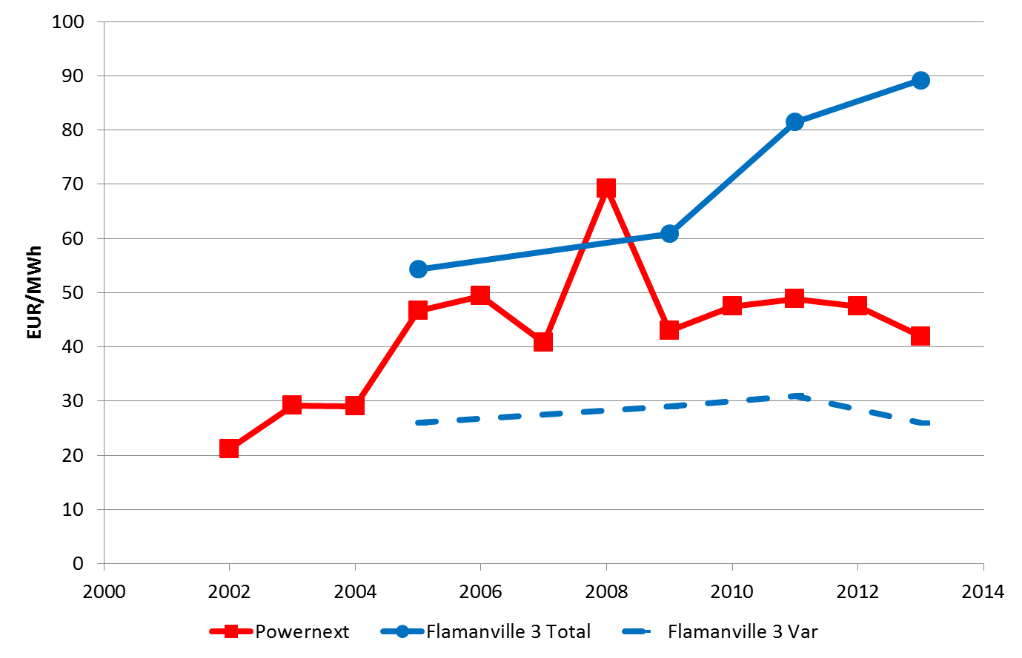
Costs vs market
prices in France
„Total“ costs Flamanville
Electricity price
FRANCE
Variable costs Flamanville

Slide 46
7. THE ROLE OF
RENEWABLES
CORE MOTIVATION:
Policy targets for an INCREASE of RES-E!
e.g. 2020/20/20/20 targets
RES-E directive: increase share of RES-E from 12% 1997 to 22% in 2010)

Slide 47
RES targets for 2020:
Source: Based on European Commission (COM(2008) 19)

Slide 48
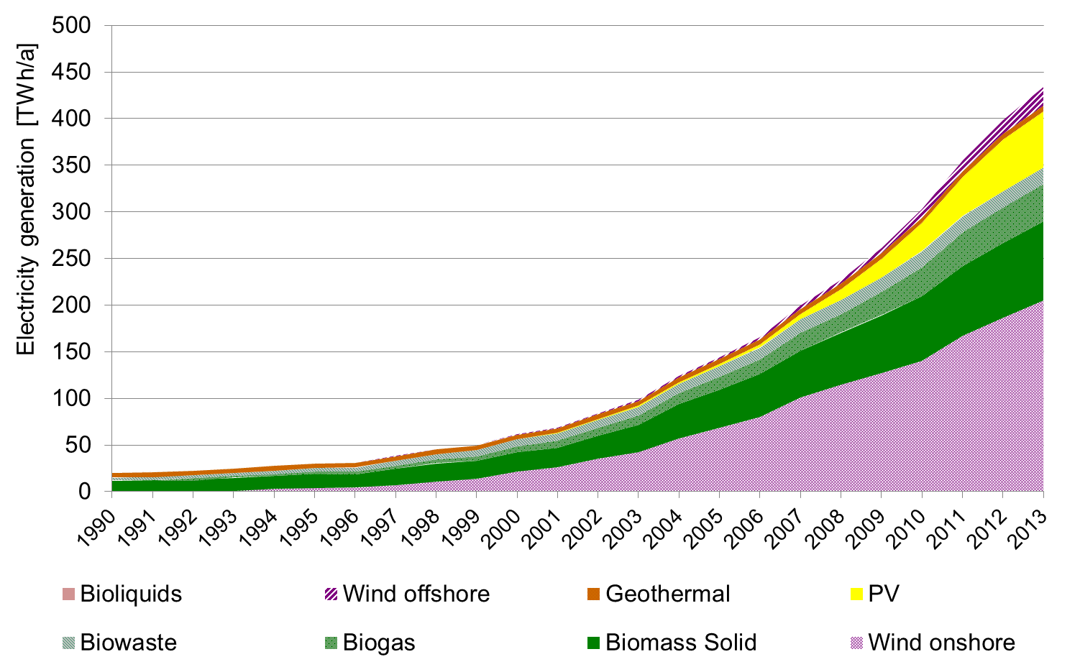
EU-27: Electricity generation
from „new“ RES
2013: 13 %
(preliminary)
1997: 1 %
Source: EUROSTAT, own estimations

Slide 49
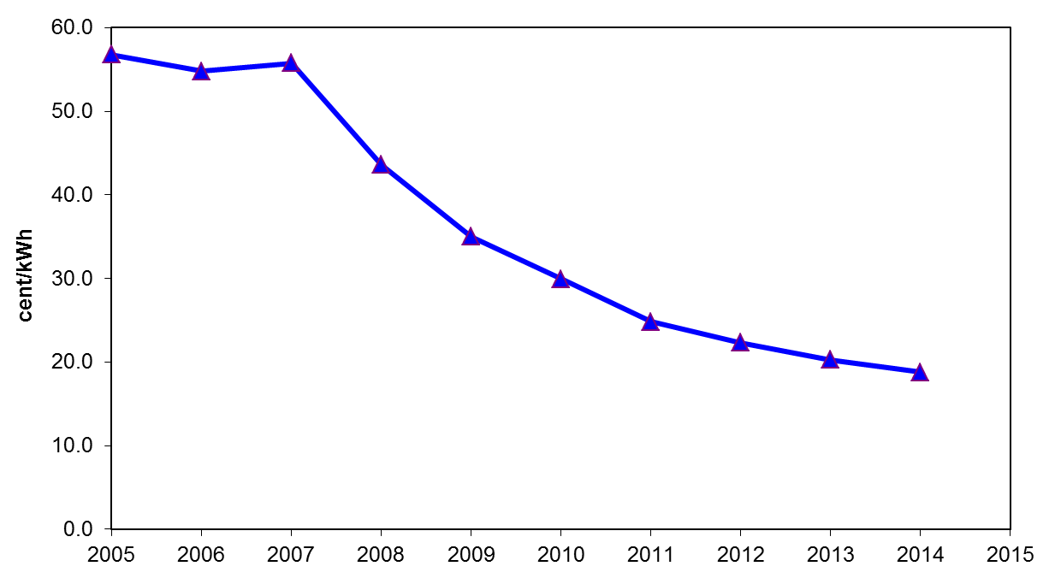
Development of
PV generation costs

Slide 50
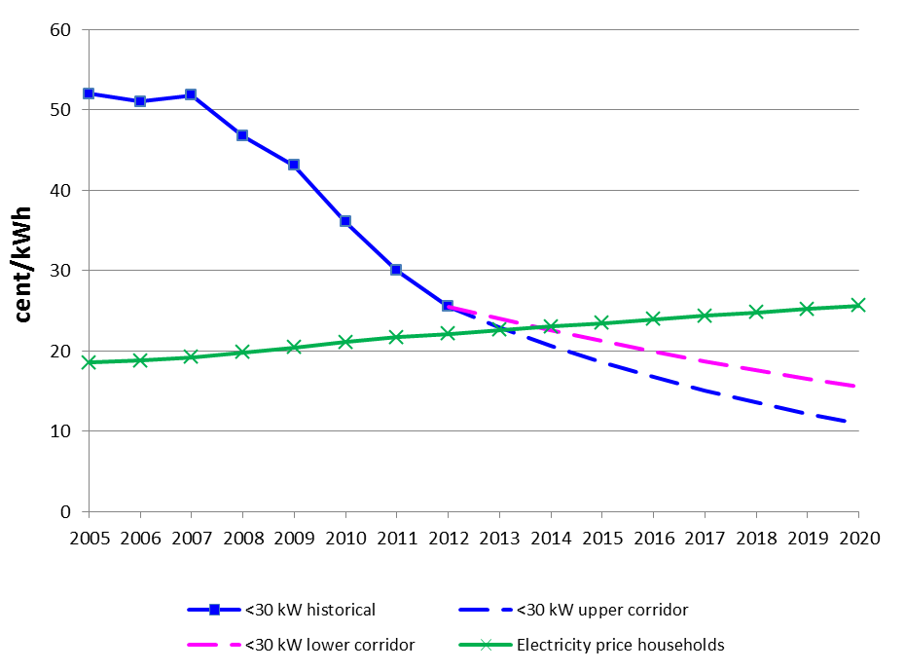
Development of PV generation
costs vs household electricity prices
Grid parity ?

Slide 51
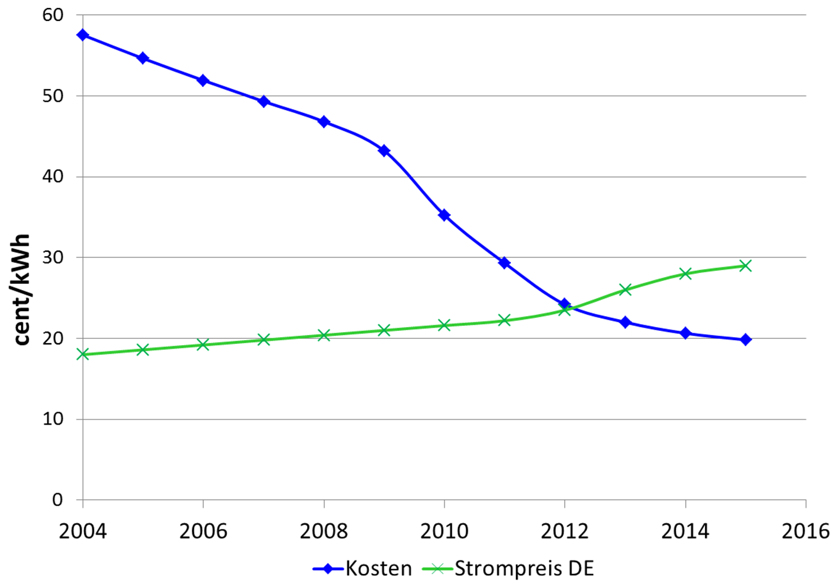
  PV-Kosten und Haushalts-
  strompreise in Deutschland
Grid
parity ?

Slide 52
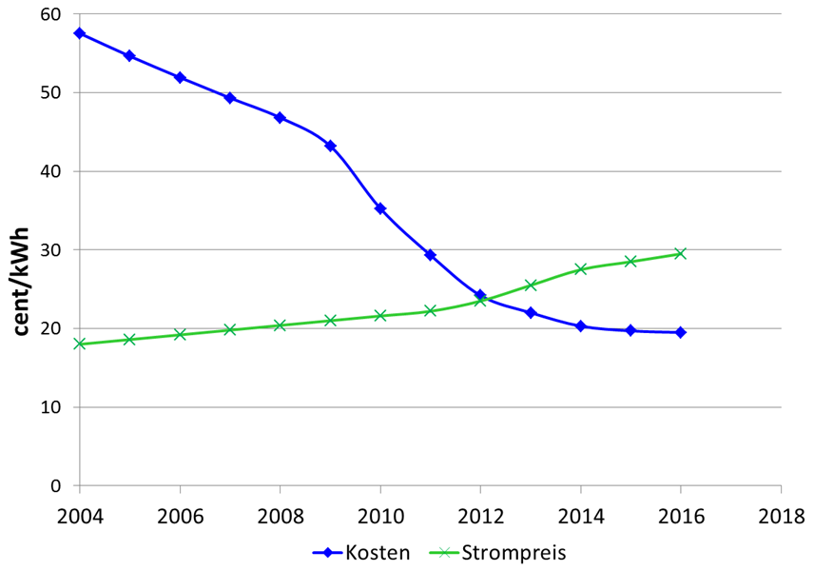

Slide 53
8. CONCLUSIONS:
Markets are in a period of transition
towards volatility;
Nuclear: long lead time, uncertain costs → high promises, low fullfilments;
Renewables: next very interesting phase:
after PV-Grid parity!
More details: Summer school

Slide 54
Example: Costs of
electricity generation from CCGT
5000 h/yr:
C = 1.20 + 0.40 + 4.31 +0.17 = 6.08 cent/kWh
1000 h/yr:
C = 6.0 + 2.0 + 4.31 +0.17 = 12.48 cent/kWh

